Slide 1

PRODUCT SALES ANALYSIS
PENS AND PRINTERS Company

Slide 2

Overview
This analysis report show some numbers of new product line which had been launched about 6 weeks with three different sales method. We have a closer look to the business, compare the performances between methods and choosing the best technique to sell the product efficiently.
Summary of work
The current number of customers and assess the compositions of each method by year of customers
The total revenue of each method and see how the revenues distributed by time
Validate the relationships between number of site visits in the latest 6 months, the number of product sold with the revenue
Observing the number of site visits of each method, the number of product sold by each method
How the current number of customers and the revenue is distributed by state.

Slide 3
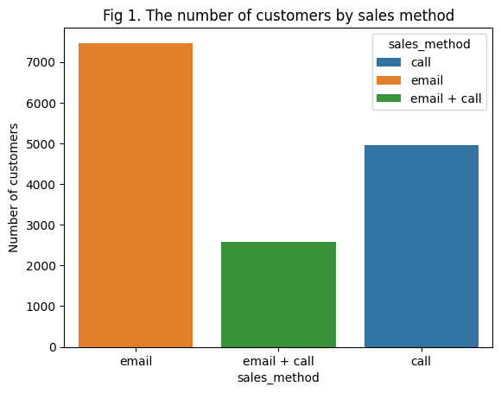
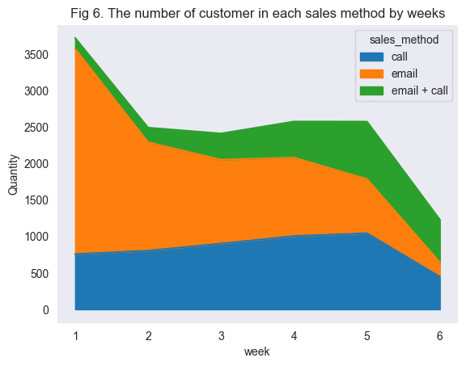
The Number of Customers
About a half of total customers, 7466, is announced about new product via email.
Call is the second preferred approach among salesman to contact with customers, with just 4962 customers
The number of customers got new line of product information through combining method is the lowest, about 2572 customers.
The number of customers in email group went down by time from approximately 2800 customers in the first week to just nearly 200 customers in the last week of the campaign.
The measure in call group peaked at around 1000 customers at the fifth week before decreased to approximately 450 customers in the sixth week.
That metric of combining method witnessed the similar trend and went on top at the fifth week with approximately 790 customers.
e

Slide 4
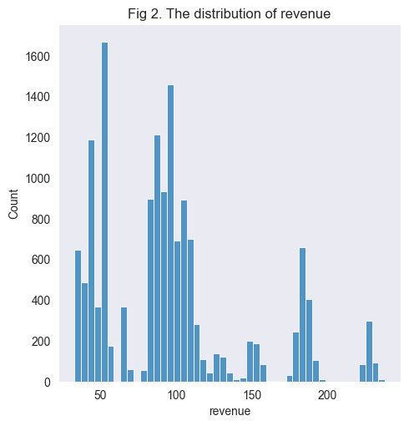
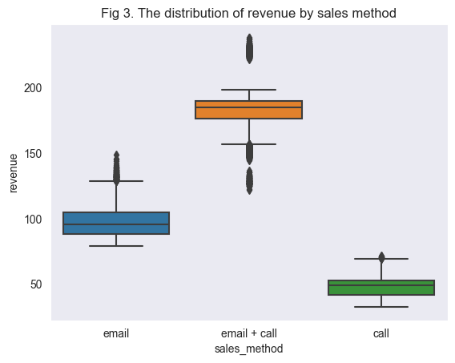
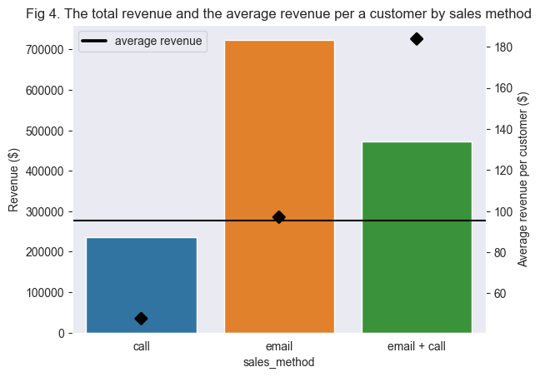
The Revenue
Some most common revenue values, those are more likely around 49 dollars, 96 dollars, and a peak at 185 dollars, these notes are convinced with visualization in Fig 3.
The distribution of revenues generated from combining method using both email and call fluctuates at a high range of price, whereas call method seems to have the lowest performance.
Combining method returned the highest average revenue per customer (184 dollars/customer), email was in around 97 dollars/customer while that metric is just approximately 47 dollars/customer with customers who educated by calling.

Slide 5
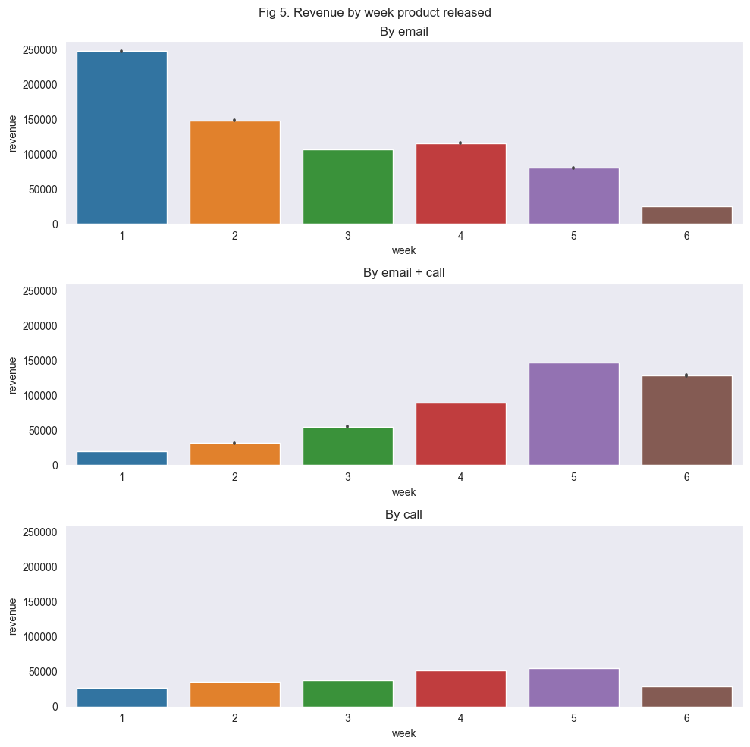
The Revenue
The revenue generated by customers who were announced about new line of products by email was the highest at the first week when new products were initially in stock, then gradually decreased in the latter weeks.
There was a contrary direction in the customers behaviours who were educated by both email and call method, in details, the revenue climbed gradually by weeks and peaked at the fifth week started from when new line of products campaign was launched.
We also saw that there are similar patterns in the number of customers in each group of method with each group's revenue perspectively.
→ The fact that the number of customers is higher, the likelihood of each method gains more revenue is higher.

Slide 6
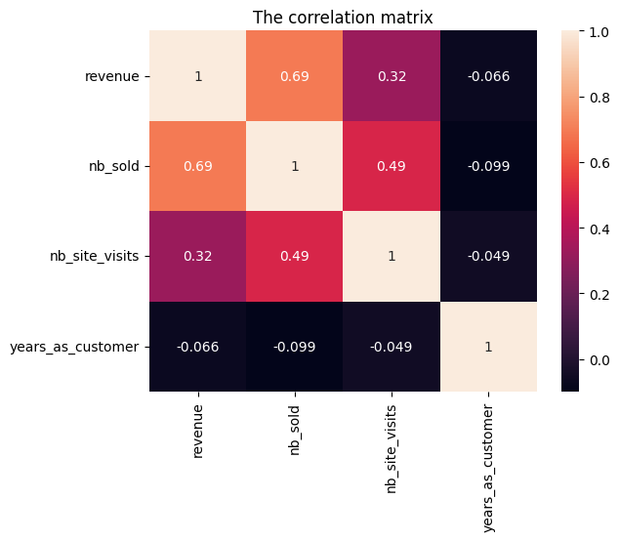
The Correlation
strong positive correlation between the revenue and number of product was sold for each customer;
a moderate positive correlation between number of sites visits and revenue, and number of products was sold.

Slide 7
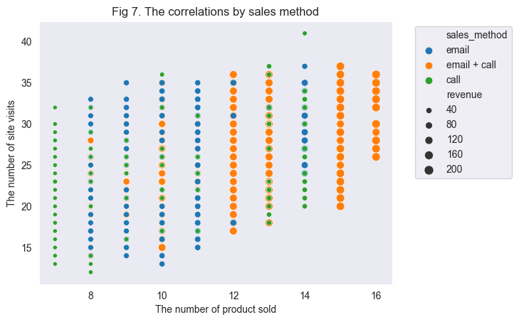
The Correlation
The number of products sold tend to be higher when the number of site visits in the latest 6 months of customers increased.
It seemed to be larger revenue when the number of products sold was higher.
The revenue tend to be larger when using the combing method.

Slide 8

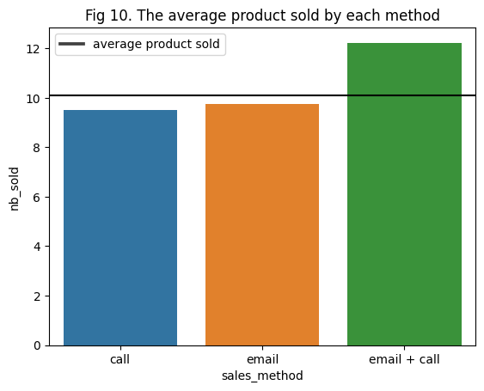
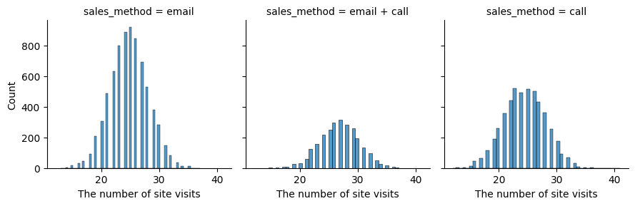
Site Visits, Products Sold, and Revenue
The average numbers of site visits, and products sold were around 25 sites and 10 products respectively.

Slide 9
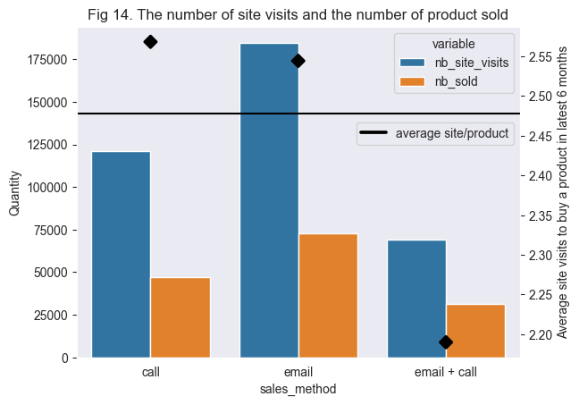
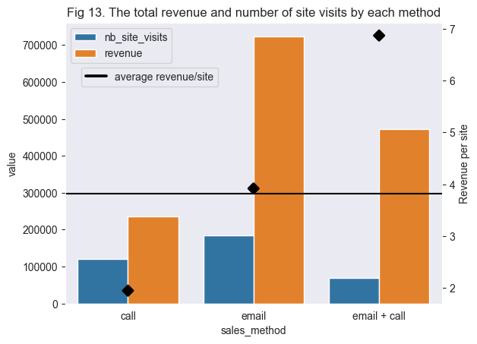
Site Visits, Products Sold, and Revenue
The measure of the average number of sites that customers visited to purchase a new product in the latest 6 months, the combining method surprisingly stood the first place with just 2.19 sites/product, followed by email methods' metric which was about 2.54 sites/product.
The current average of dataset is approximately 2.48 sites.
The revenue per each site captured from customers educated by combining method was dominant to the remaining methods, with approximately 6.86 dollars per site,
That measures of call, and email methods were around 1.95 dollars, and 3.92 dollars respectively.
The average value of metric of this current dataset is around 3.82 dollars per site.

Slide 10
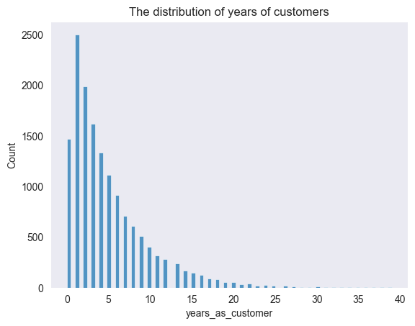
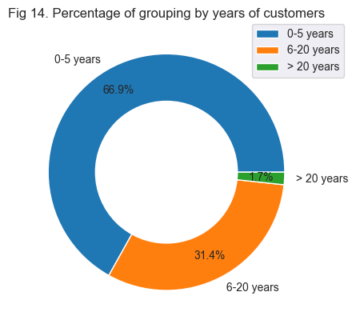
Years as customer
The number of 0-5 years of customers captured a large quantity of distribution while the people being customers of the Pens and Printers from 20 years are quite small.
Around 31,4% of current total customers have already had 6-20 years relationship with Pens and Printers.
The percentage of long-lasting more than 2 decades accounted just around 1.7%.
The majority of current customers have long-lasting relationships with the company from 0-5 years, holding up to 66,9%.

Slide 11
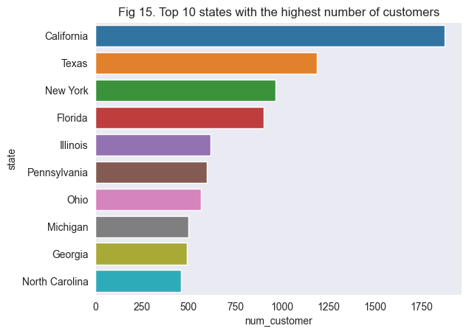
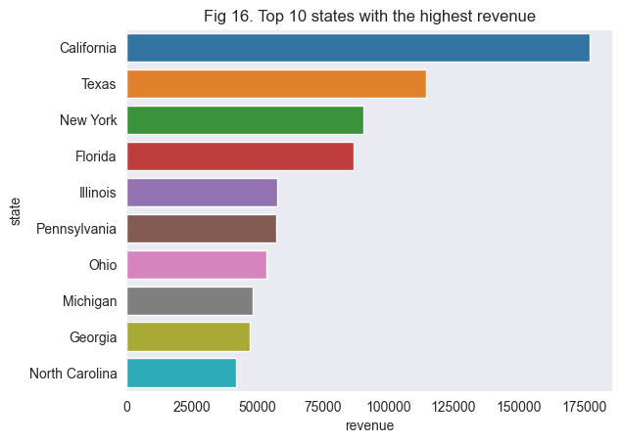
Customers and Revenue by States
10 of 50 states having the highest number of customers accounted for more than a half of total customers.
2 states that have above one thousand customers, including California and Texas, with 1872 and 1187 customers respectively while 965 customers, and 904 customers have shipping addresses at New York and Florida in turn.
There was no differences in the order of top 10 states which had the highest revenue compared to those number of customers. California ranked first with total of around 176000 dollars, Texas followed with nearly 115000 dollars.

Slide 12

THANK YOU!

